Slide 1

Predicting Customer booking Buying Behavior
01/17/2025
Rutik Narute, Graduate Student at Cal State La

Slide 2
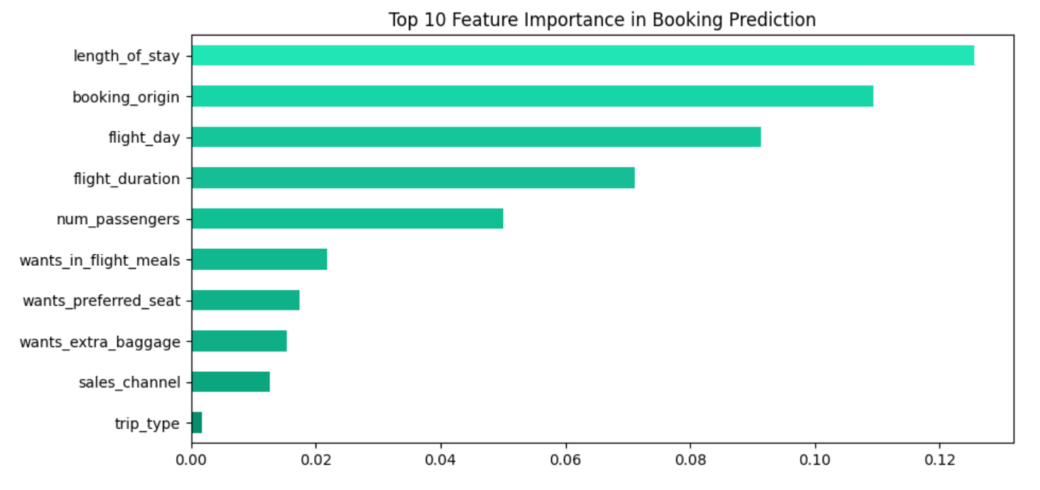
predictive model to understand factors that influence buying behavior
The model achieved an accuracy of 86%, indicating that it correctly classifies the majority of cases.
The AUC-ROC score of 0.77 suggests that the model has a decent ability to distinguish between the two classes.
The model is good at correctly identifying when a customer will not book , which is 8395.
Among the five features, length_of_stay, booking_origin, flight_day, flight_duration and num_passengers are the most important columns, significantly influencing booking decisions.

